Slide 1
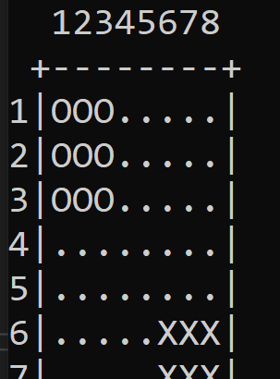


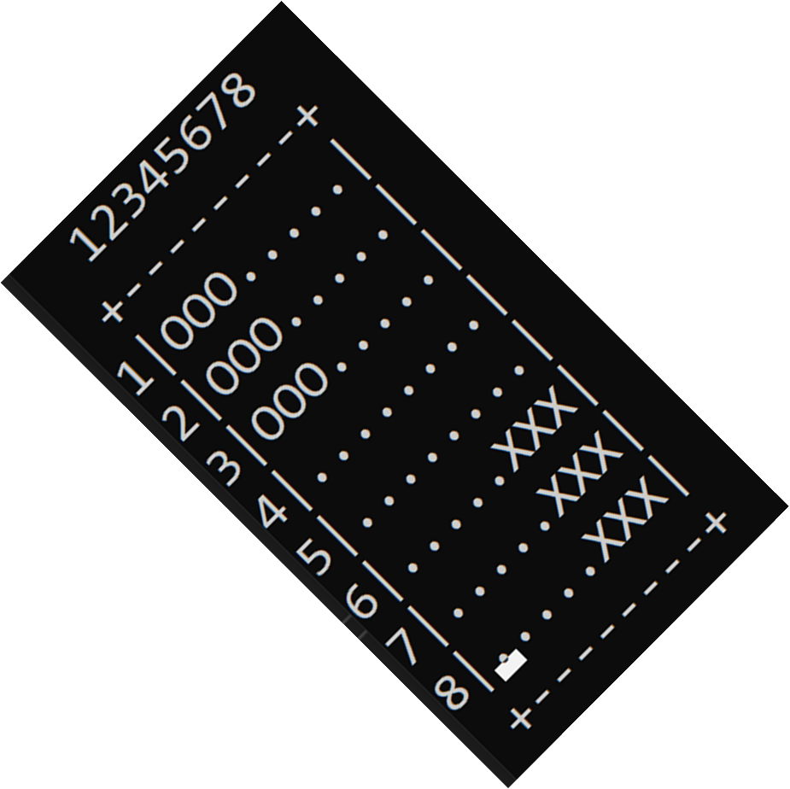

PROJECT-III CENGERS
CME1251 PROJECT BASED LEARNING – I
BY
-----------------------------------------------------------------------------
2020510007 FATMA CEREN AKYUZ
2020510027 TUGRUL DEMIROZER
2020510047 BEDIRHAN KARAAHMETLI

Slide 2
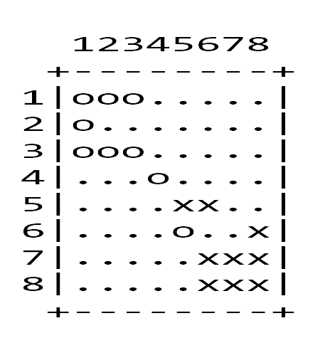
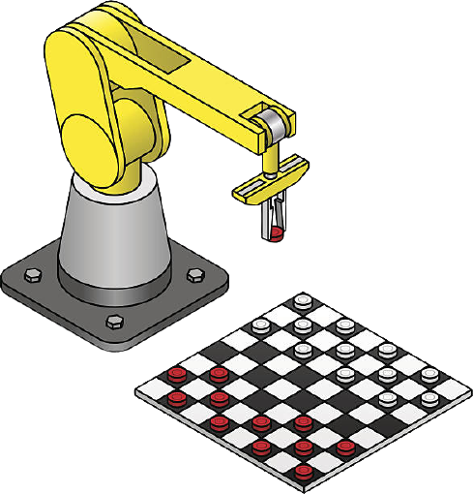


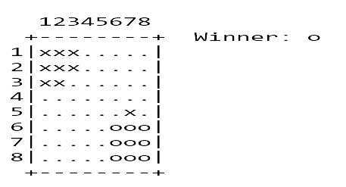

WHAT IS CENGERS ?
The game is played between human (x) and computer (o).
Human starts the game.
The goal of the game is to be the first player to move all 9 pieces across the board and into their own home area.

Slide 3


REQUIREMENTS
Two-dimensional arrays
For loops
SetCursorPosition command
Methods
ReadKey command
If-else statements
Boolean variables
Environment.Exit command

Slide 4



TASK SHARING
THINKING
DESIGNING
TAKING ACTION
TESTING
DEBUGGING

Slide 5


SCHEDULING
WEEK 1
Discussing
Thinking
Planning
Scheduling
Creating necessary variables
Screen
Creating methods
WEEK 5
For computer:
Double jump operation
Thinking additional improvements
Testing
Debugging
WEEK 2
For human:
Cursor moves
Choosing piece
Choosing target
Step operation
WEEK 4
For computer:
Single jump operation
For human:
Single jump operation
Successive jump operations
WEEK 3
For computer:
Step operation

Slide 6

COMPLETED TASKS
Creating necessary variables
Screen
For human:
- > Cursor moves
- > Choosing piece
- > Choosing target
- > Step operation
- > Single jump operation
- > Successive jump operations
For computer:
- > Step operation
- > Single jump operation
- > Double jump operation

Slide 7
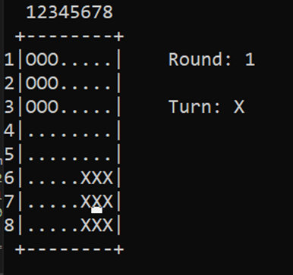
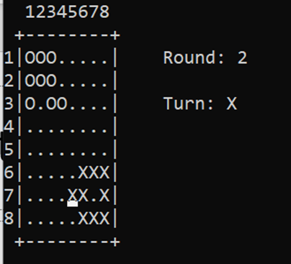

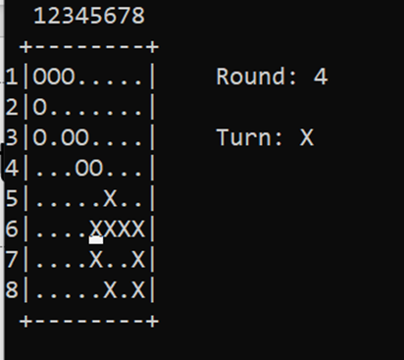
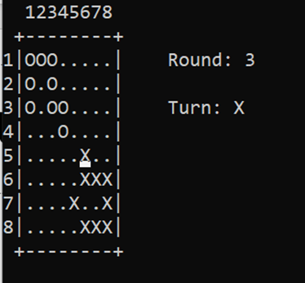
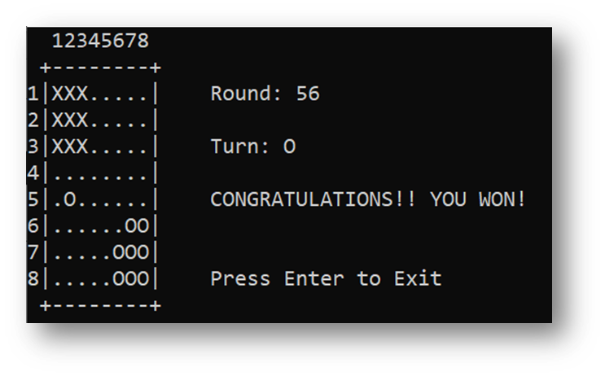
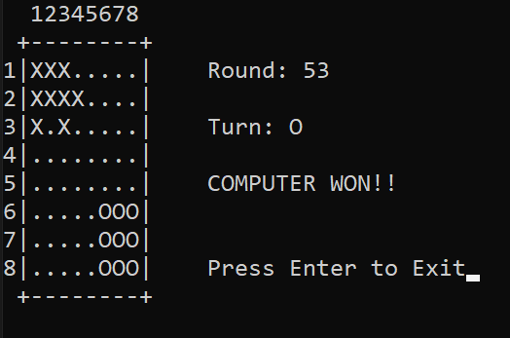
SCREENSHOTS

Slide 8


PROBLEMS ENCOUNTERED
When it was the turn of the computer, when there were no moves to the right or down, the pieces were getting stuck.
The pieces of the computer were not collected in the 3x3 area.
Human could make multiple pieces jump during their turn.
Human could move piece diagonally.

Slide 9
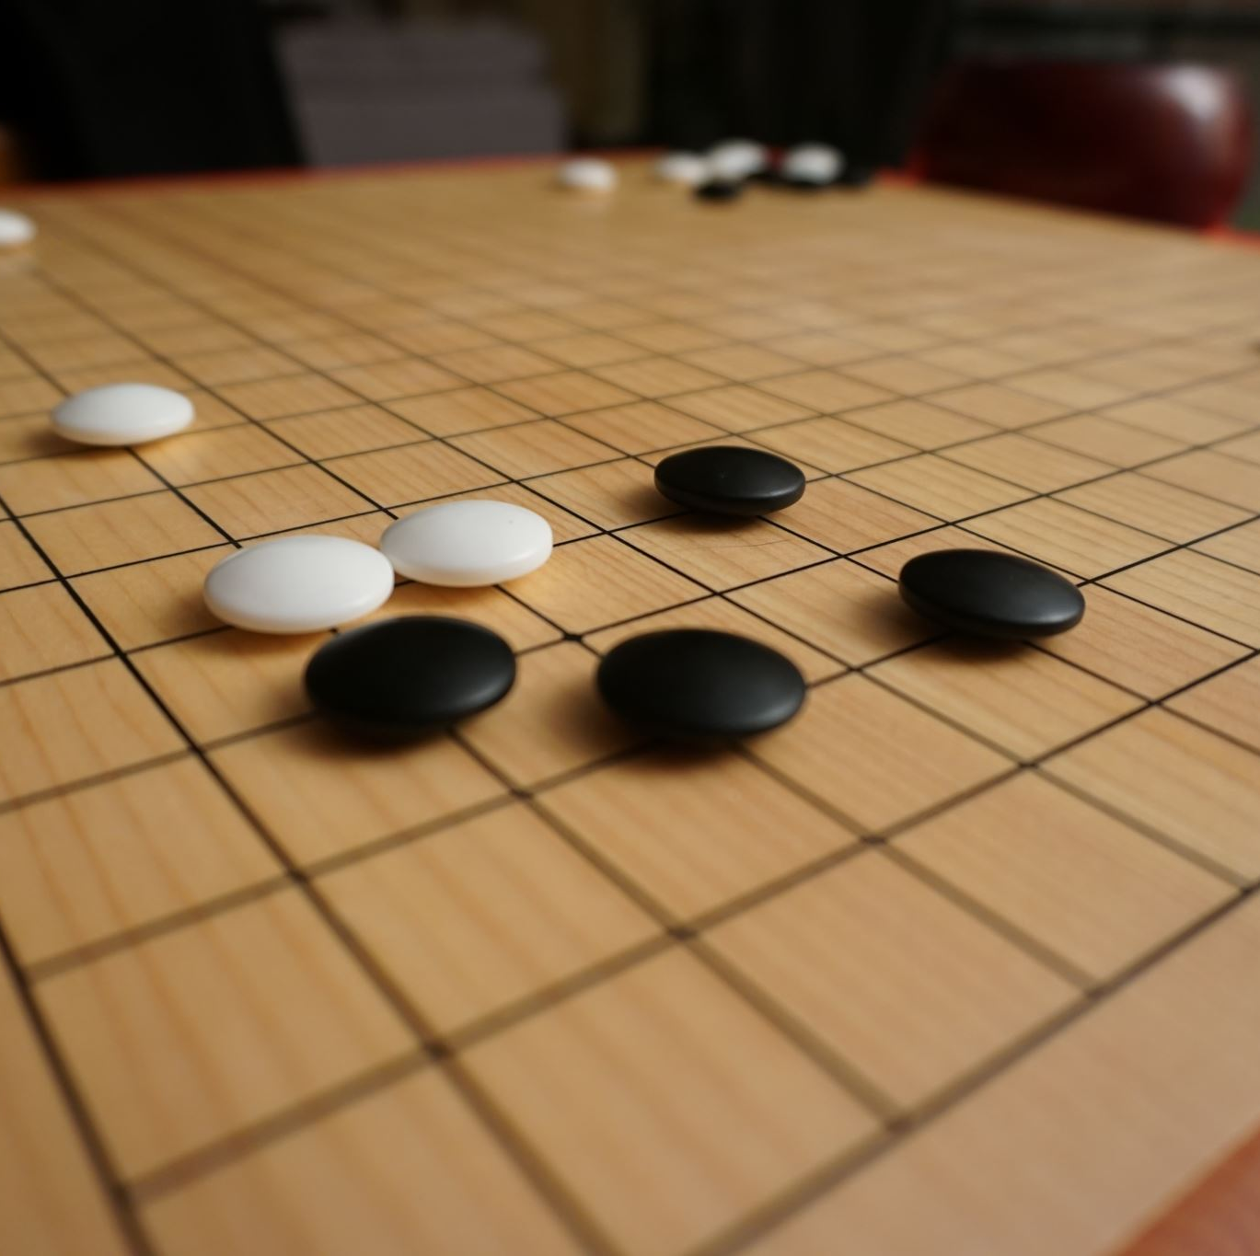

ALGORITHMS AND SOLUTION STRATEGIES
Two-dimensional arrays for; game table, x and y-axis of the ‘o’ pieces, the maximum number of moves they can do, and temporary locations
Functions for the control of human movements, the endgame winner, the AI control and reverse control
ReadKey command to move the cursor
SetCursorPosition command to determine the location of the cursor
An infinite while loop for human’s turn
Switch cases for cursor movements
Boolean variables for functions and loops
Nested for loops for arrays
Environment. Exit command to leave the game

Slide 10





CONCLUSION
Artificial Intelligence development
Team work
Planning and programming
Time management

Slide 11
REFERENCES
https://docs.microsoft.com/tr-tr/dotnet/api/system.environment.exit?view=net-6.0
https://docs.microsoft.com/tr-tr/cpp/c-language/recursive-functions?view=msvc-170

